Slide 1


Slide 2
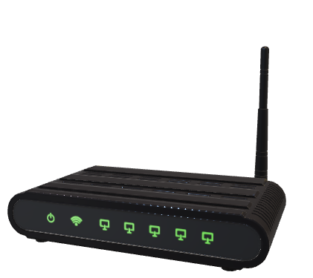
Minor Project – 1 Data Link Layer (L2 Routing) Implementation (TCP/ IP Stack Functionality)
End-Sem Presentation
In fulfillment of the requirements
For the course of
Minor Project-1
Under the guidance of
Ms. Avita Katal
By
Kshitiz Saini | 500067035 | R171218058
Saloni Saxena | 500067409 | R110218131
Pratyusha Agarwal | 500068293 | R110218107

Slide 3
1. Abstract
In today’s world, fast and efficient communication on the network between the sender and receiver is very important. For this communication, data is converted into packets and sent over the network using various routing algorithms. In a network or over multiple networks, routing refers to the process of determining a path for a packet to travel from. L2 Routing is based on the concept of Data Link layer and happens when data is to be transferred between the same subnet. In this project, we aim to implement the functionality of Data Link Layer like creating ARP tables, L2 Routing, MAC learning, L2 Switching & implementing VLAN forwarding.
Keywords : Network Routing, TCP/IP, Network Graph, ARP, L2 Routing, L2 Switching, Packet, Socket Programming, Topology, VLAN, MAC Learning

Slide 4
2. Problem Statement
The transmission of data from one device to another without the help of TCP/IP stack is only feasible for a geographically small area but when it comes to worldwide solutions, it is not very appropriate. The problem without the TCP/IP Layer is to transmit data through the shortest path using features like creating ARP Tables and MAC Learning for an optimal resolution. Another problem is to create a network to share the data and a new medium has to be used for transmission every time.

Slide 5
3. Objectives
The main objective is to implement the data link layer. The project focuses on the practical implementation of L2 Routing, L2 Switching and VLAN based forwarding where the concepts of ARP Resolution, MAC Learning and Forwarding will be used. Alongside, implementing the concept of Routing and Switching Algorithms, GL Threads, Timers, CLI Integration will also be in consideration.
Sub-objectives for the project are:
Developing a generic graph topology
Tackling the issues of thrashing, collision and reducing broadcast domain
Implementing ARP, L2 routing, MAC learning and L2 switching

Slide 6
4. Methodology
Agile methodology of software development will be followed for the proposed project. The project is divided into 12 sprints where the sprint 7 and 8 will consist of parallel development by different members of the team. Each sprint is provided ample time to complete itself as well as to maintain the product's backlog (if any). The project can accommodate changes if required at any stage of the project. The sprints 1, 2 and 3 are specifically for requirement analysis and designing of the project. One sprint is specifically designed for setting the environment like maintaining the Version Control (Git in our case) and Makefile. Each development sprint is followed by Unit Testing and an Integration Testing at the end. Sprints are also designed for the reviewing as well as retrospection part. After all the sprints the project is expected to complete by November 30.
ARP Resolution:
ARP Request message is broadcasted to all devices on the network.
Nodes determine if they are the intended target.
If nodes are the intended target, they proceed to STEP 3
If they are not the intended target, they discard the request and proceed to STEP 4
Intended device sends ARP Response to the sender in unicast mode.
END
L2 Switching:
When the frame reaches the L2 switch, it updates its table with the MAC address of the source machine corresponding to the port number at which the frame is received.
L2 switch forwards the packet.
If it does not contain the MAC address of the destination machine corresponding to any port, it floods the packet.
If it contains the MAC address of the destination machine, step 3 is followed.
Frame is received only to the intended machine.
END

Slide 7
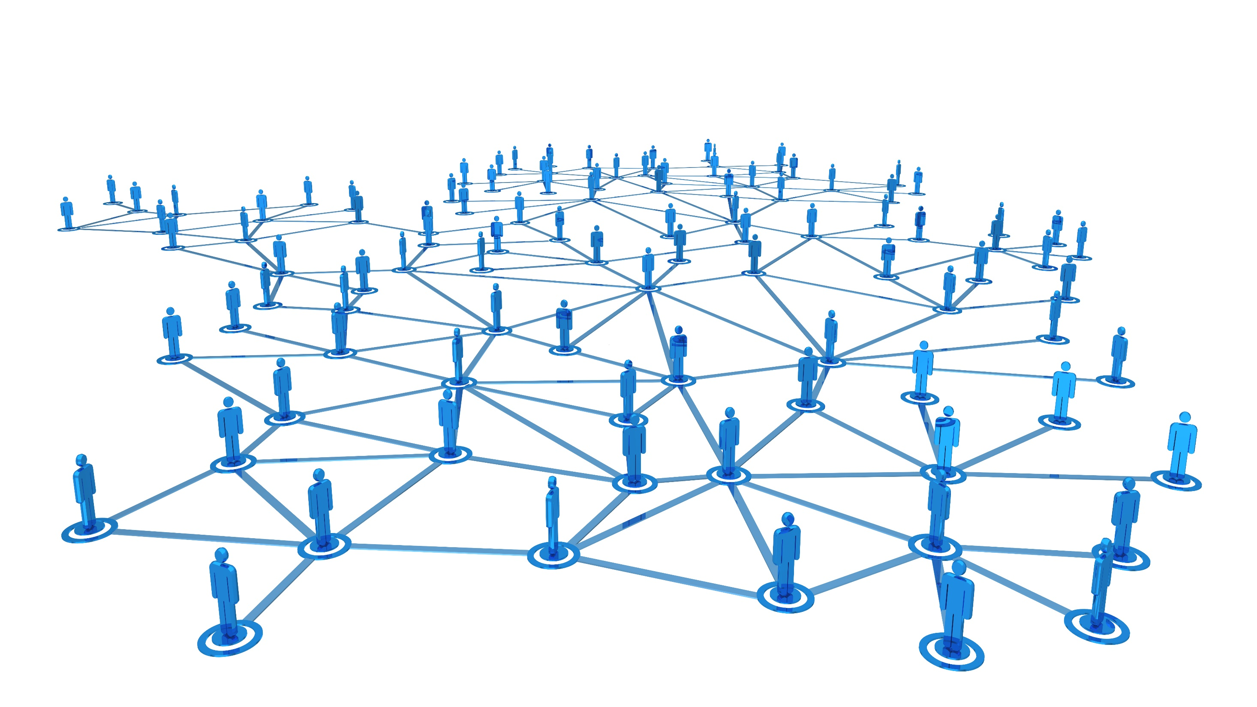
5. Implementation
5.1 Creating a Generic Graph
5.2 Implementing a Network Topology
5.3 Setting up CLI
5.4 Adding the Communication Properties
5.5 Implementing Address Resolution Protocol
5.6 Implementing L2-Switching
5.7 Data Flow Diagram

Slide 8

5.1 Creating a Generic Graph

Slide 9
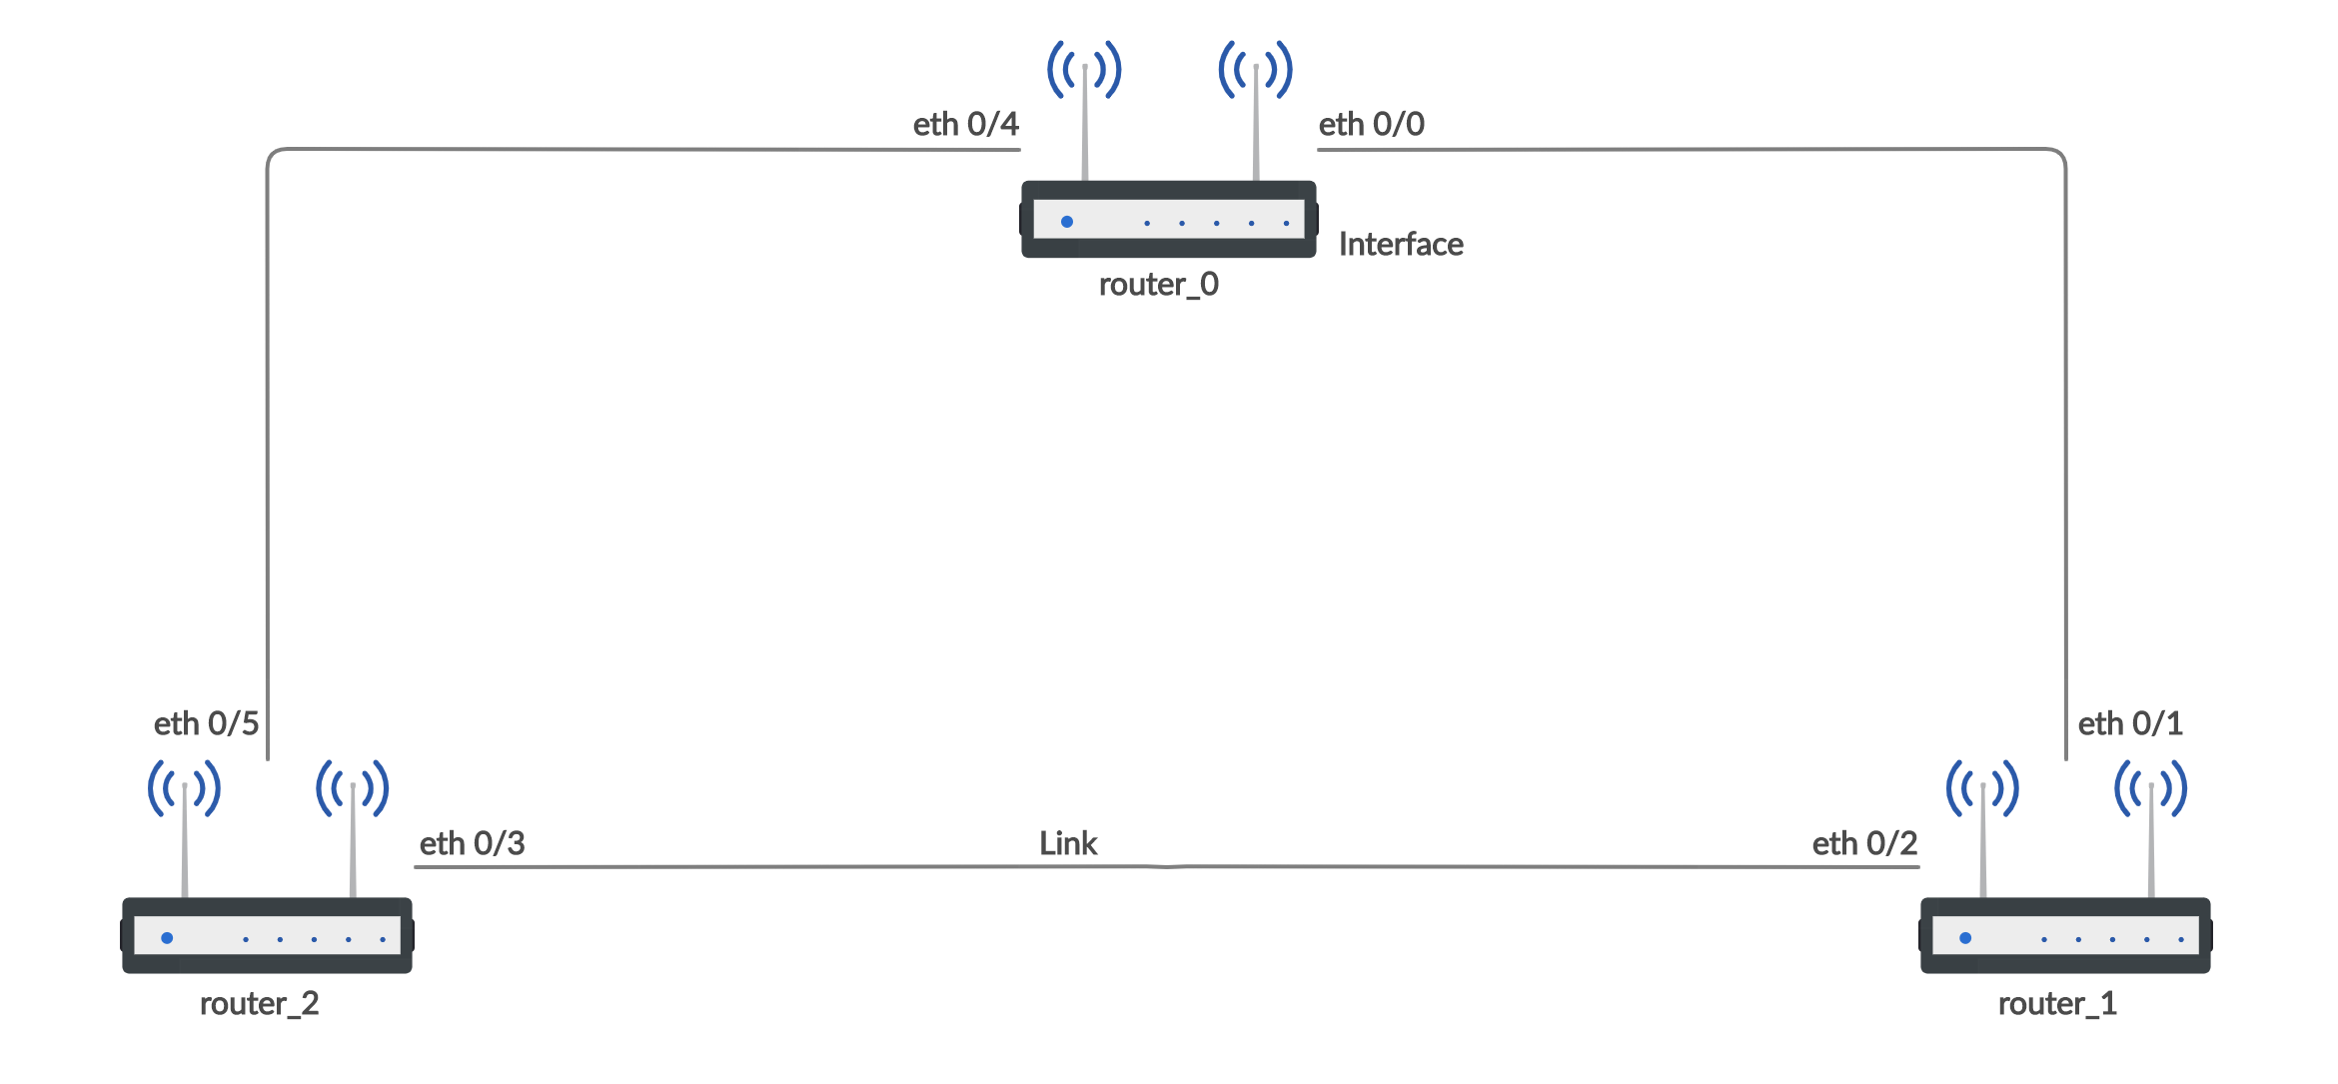
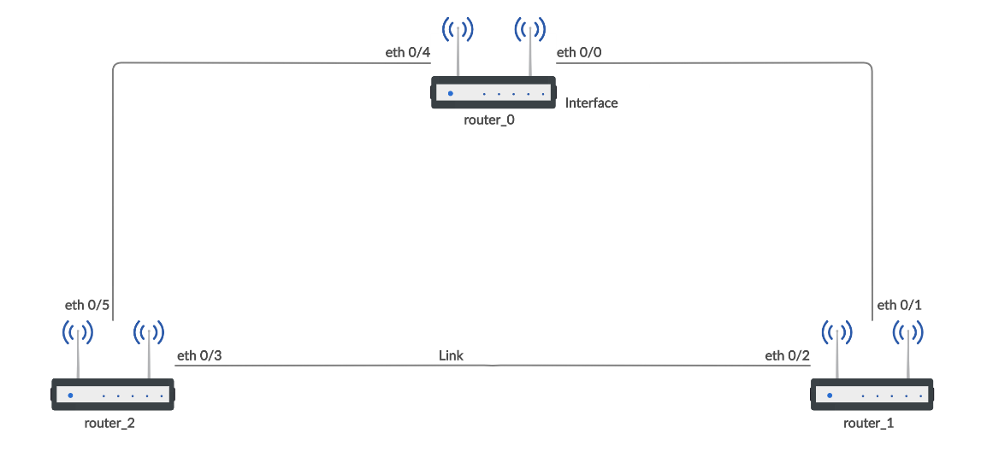
This project is started by the implementation of Graph Data Structure which is further used to show the functionality of networks. It is a data structure that can be made once and can be updated as many times according to ones need.
A graph as known is a collection of nodes.
Each node has its own interface.
Two interfaces are connected to each other via links.
Figure 1 Generic Graph Diagram

Slide 10
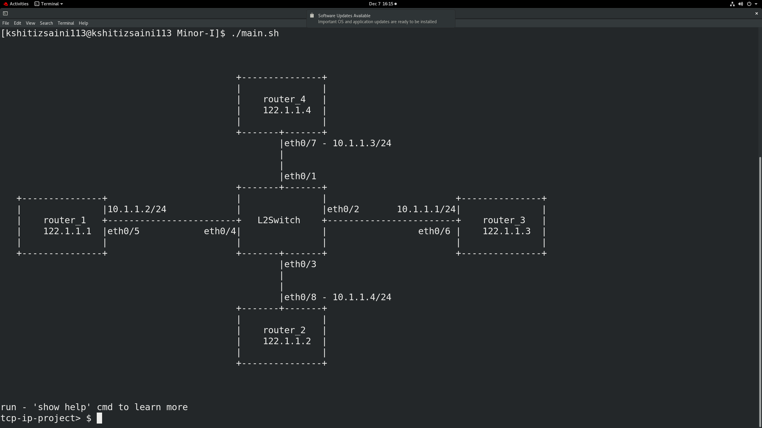

Figure 2 Generic Graph Implementation

Slide 11
5.2 Implementing a Network Topology

Slide 12
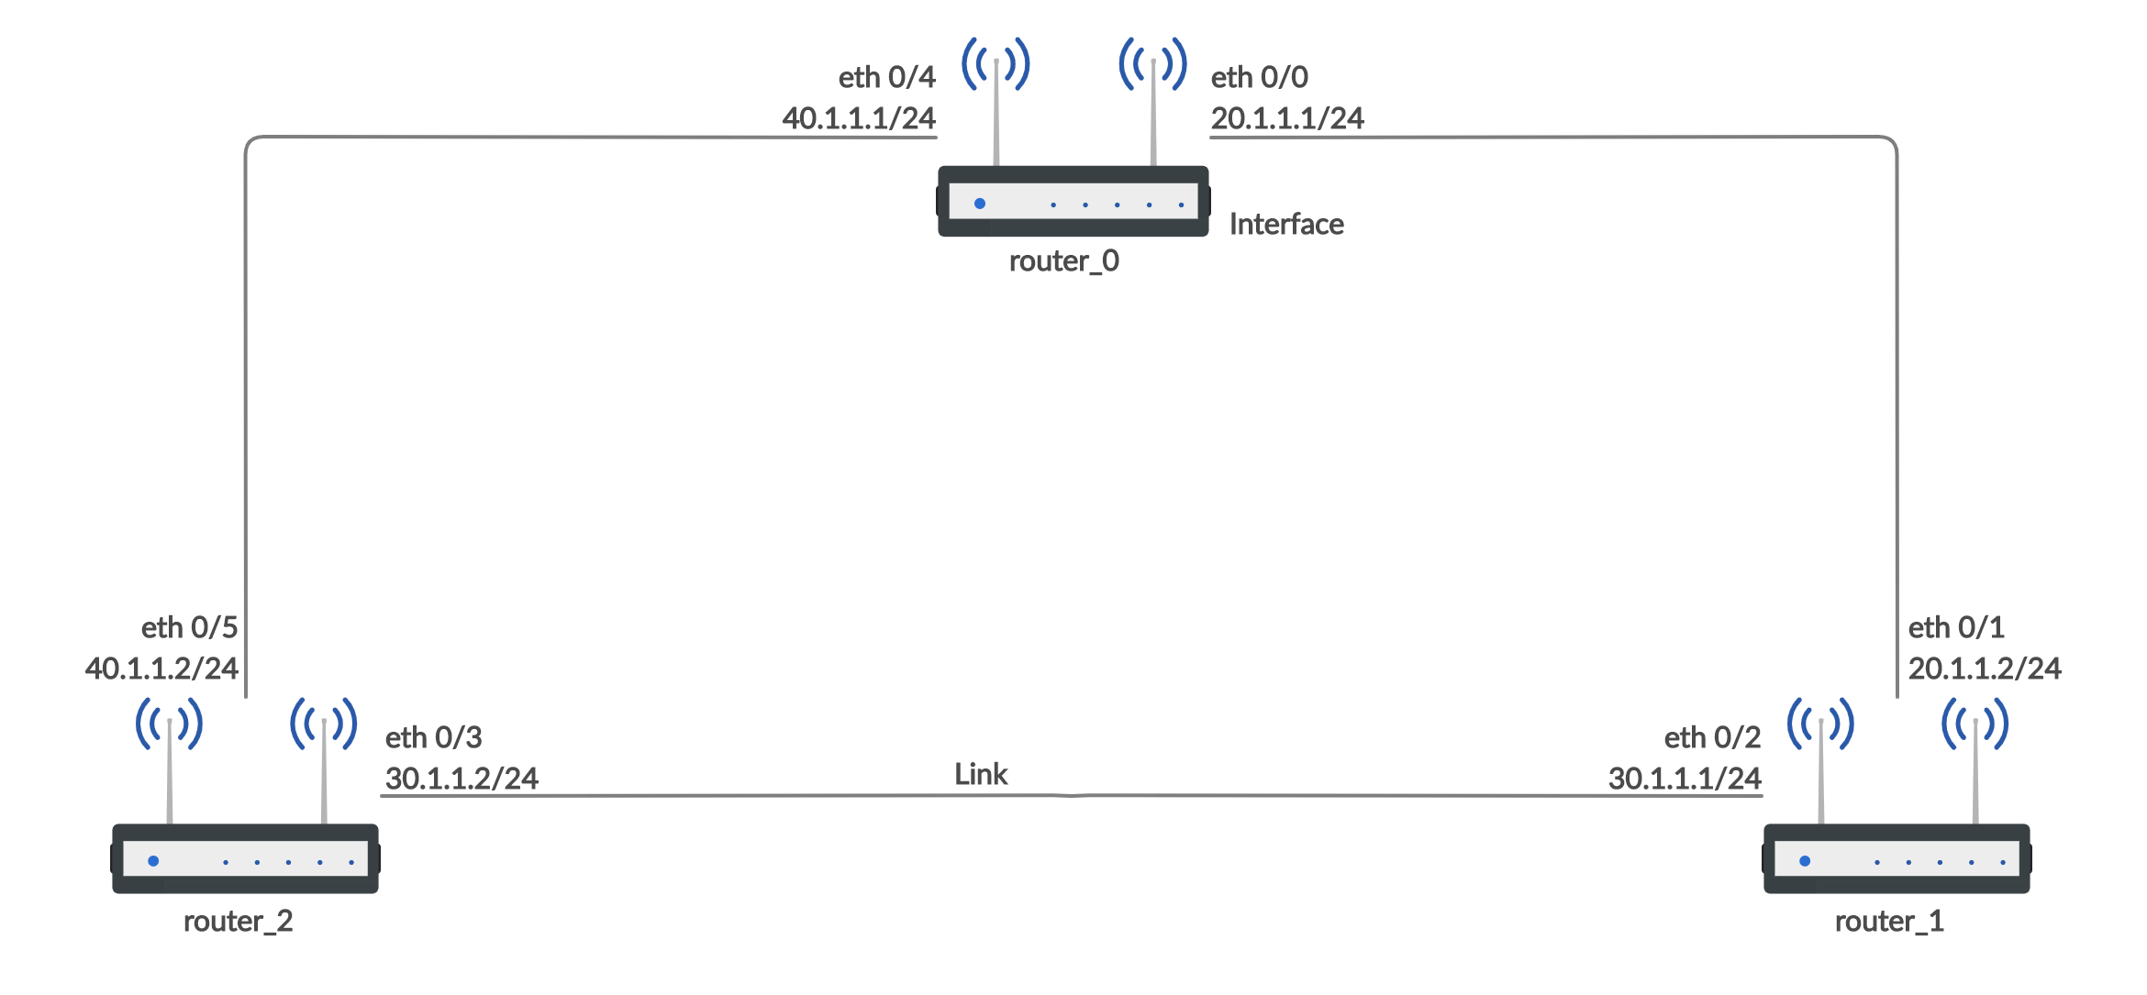
After the implementation of Graph Data Structure we continues to add Network Properties to the Generic Graph i.e. IP, MAC Addresses and Subnet Mask. We are adding IP and MAC by creating our self defined Data Structure.
Loopback Address is the unique address of a device.
Each node has its own network properties.
Links connecting nodes also have their own network properties.
Figure 3 Network Topology Diagram

Slide 13
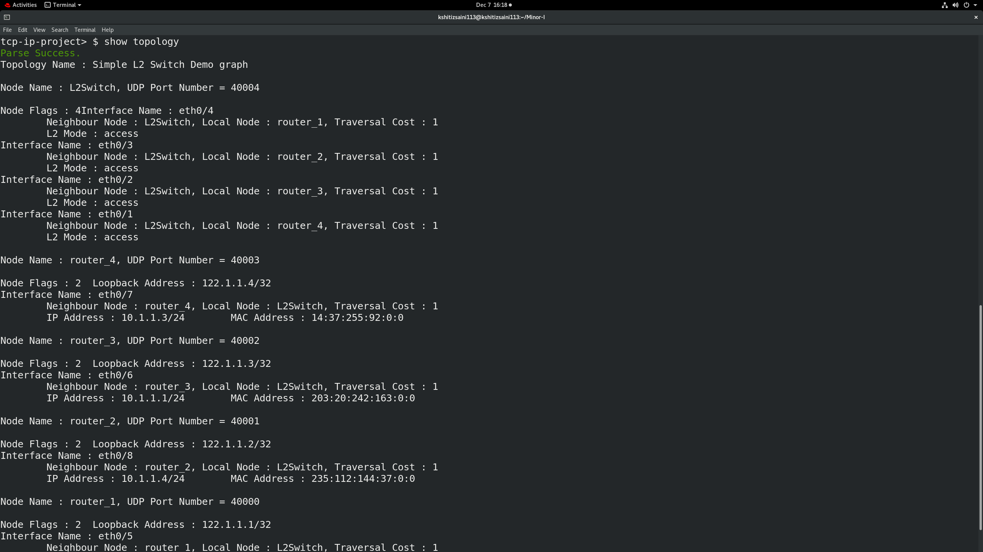
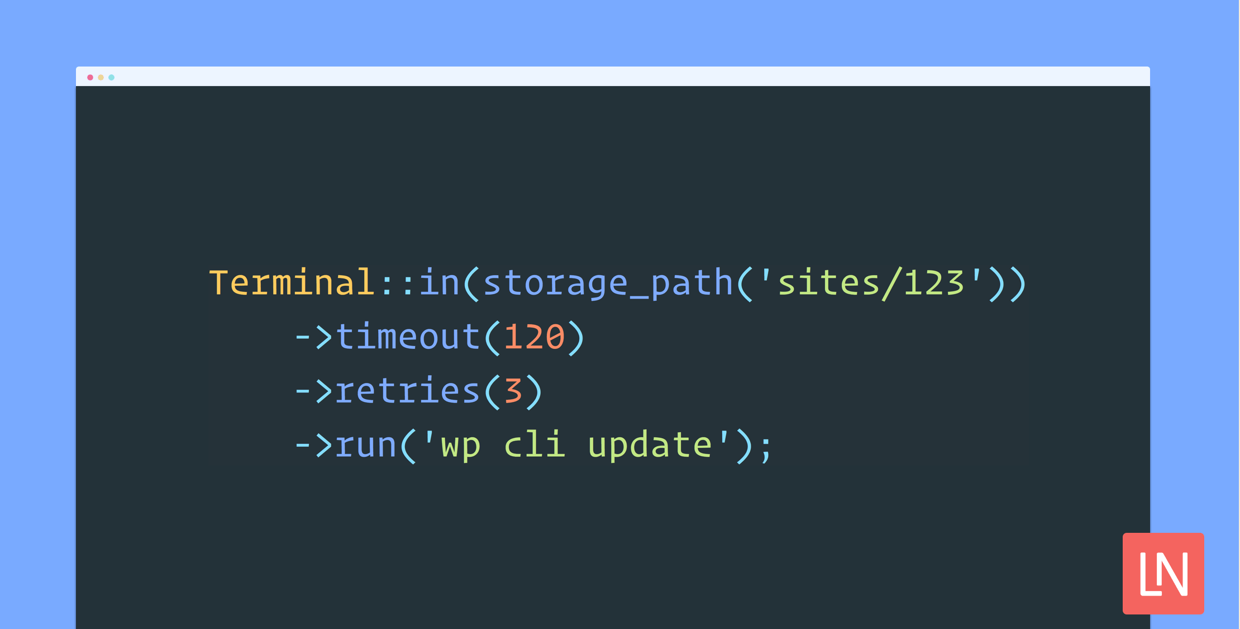
Figure 4 Network Topology Implementation

Slide 14
5.3 Setting up a CLI

Slide 15
CLI Responsibilities
Validate command syntax.
Validate if leaf node values are compatible with given leaf node expectations.
Send command to the project along with leaf node values for command processing.

Slide 16
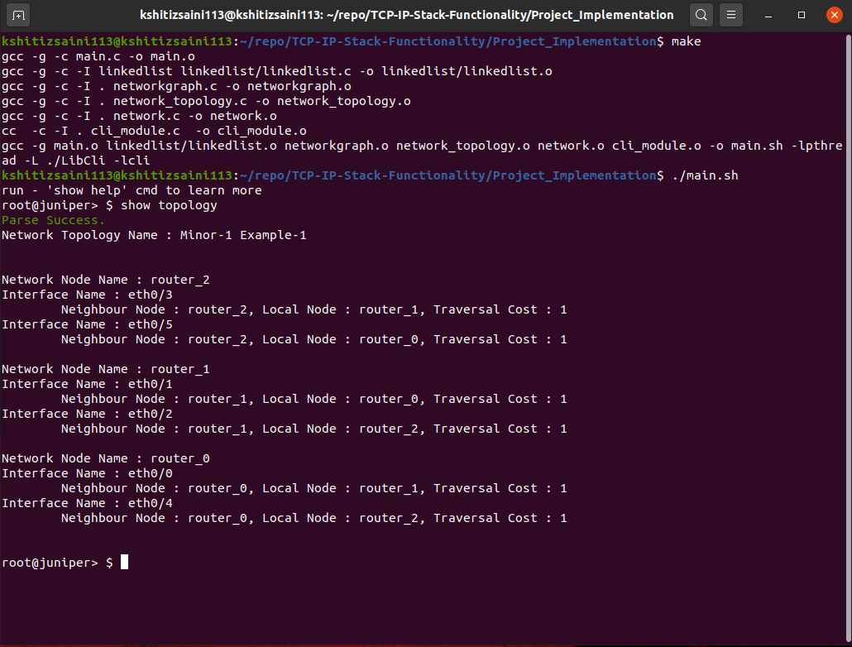

Figure 5 Implementation of CLI

Slide 17

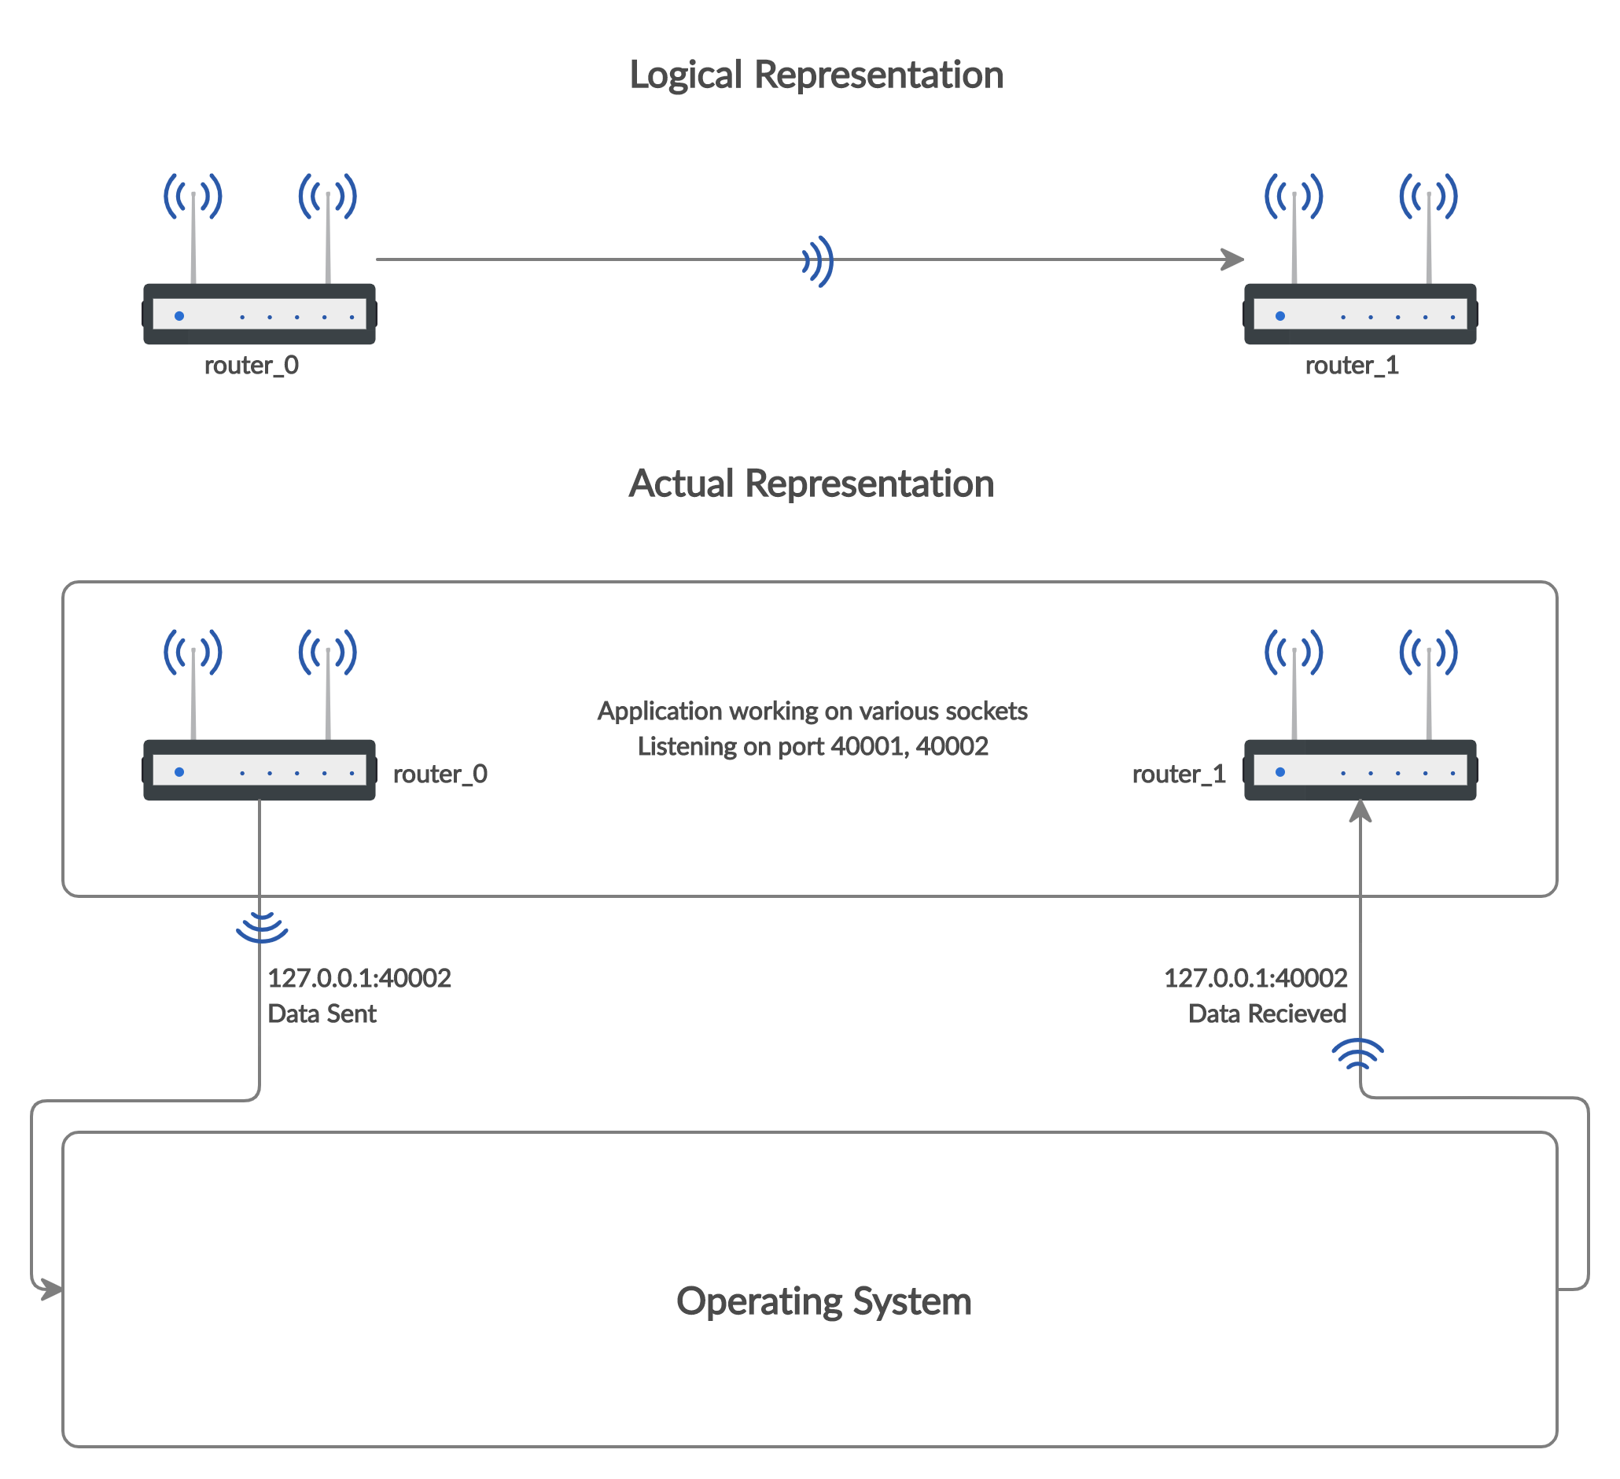
5.4 Adding the Communication Properties

Slide 18
Figure 6 Logical-Actual View Communication

Slide 19
Communication Algorithm
Assigning unique UDP port number to each node of the topology.
Opening a UDP socket for all port numbers.
Listening on all UDP sockets.
Nodes communicates by sending data to dest. node with IP=127.0.0.1.
Underlying OS echoes back all data back to the application.
Handing over the data to the destination port number.
Using auxiliary information, recipient interface name is known.
Actual frame is received to the destination node on an given interface.

Slide 20
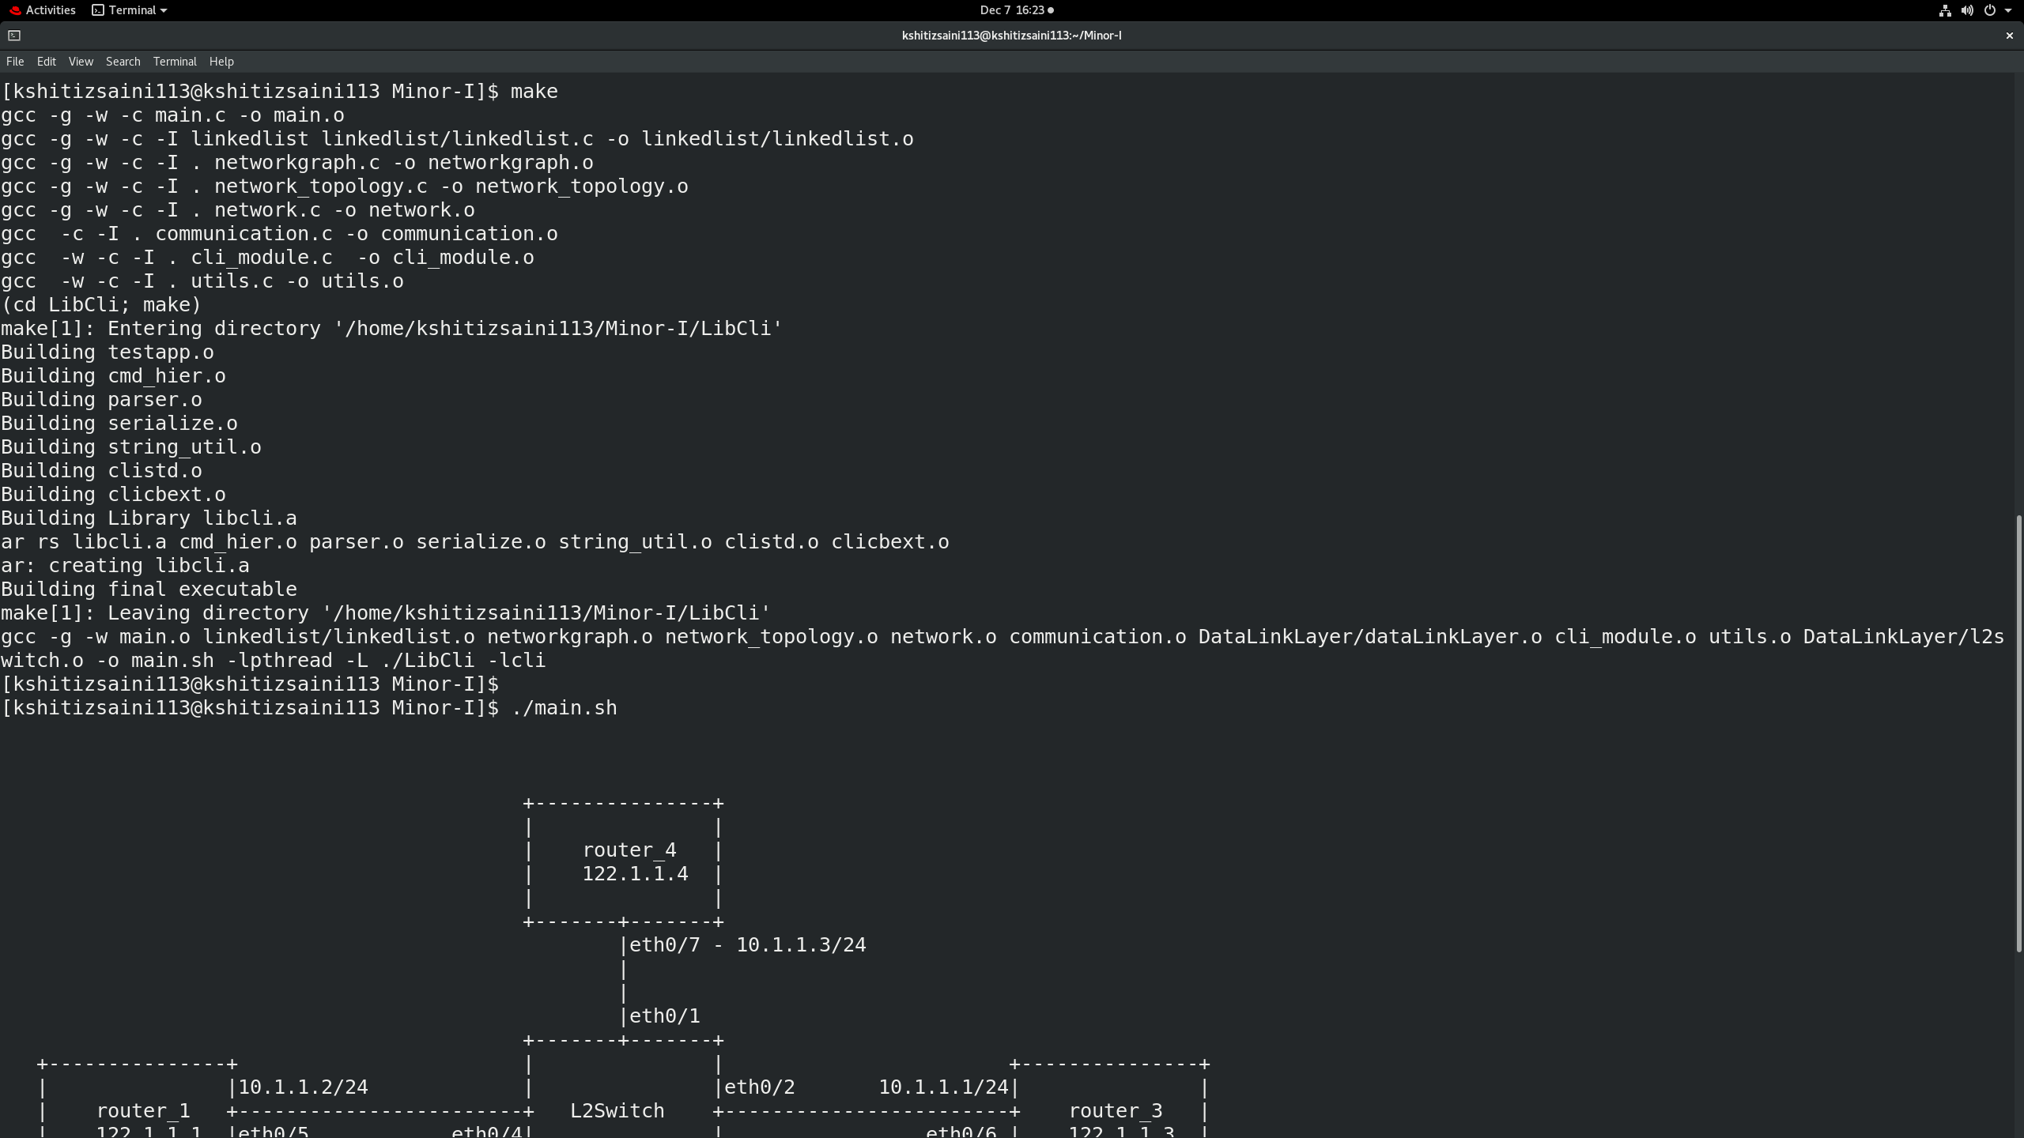
Figure 7 Communication between nodes

Slide 21
5.5 Implementing Address Resolution Protocol

Slide 22
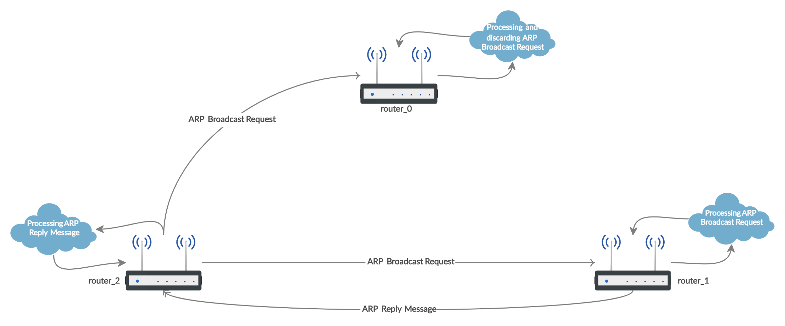
ARP Tables are created to store the ARP Data in the project. LinkedList is used for the storing of ARP Table. A view of the system depicting the functionality is defined as,
Figure 8 ARP Cycle

Slide 23
ARP Algorithm:
1) Host Machine wants to send a frame to the designation machine.
2) Host machine looks into its ARP table for the IP address of the destination machine.
a. If MAC address corresponding to the IP address of the destination machine is present then frame is delivered.
b. If MAC address corresponding to the IP address of the destination machine is not present then step 3 is followed.
3) The host machine sends the ARP broadcast request to the network.
4) Only the machine whose IP address is mentioned in the ARP broadcast request responds, rest of the machine discards the request.
5) Destination machine sends an ARP reply to the host machine.
6) Host machine gets the ARP reply and add the MAC address corresponding to it’s IP Address to its ARP Table.

Slide 24
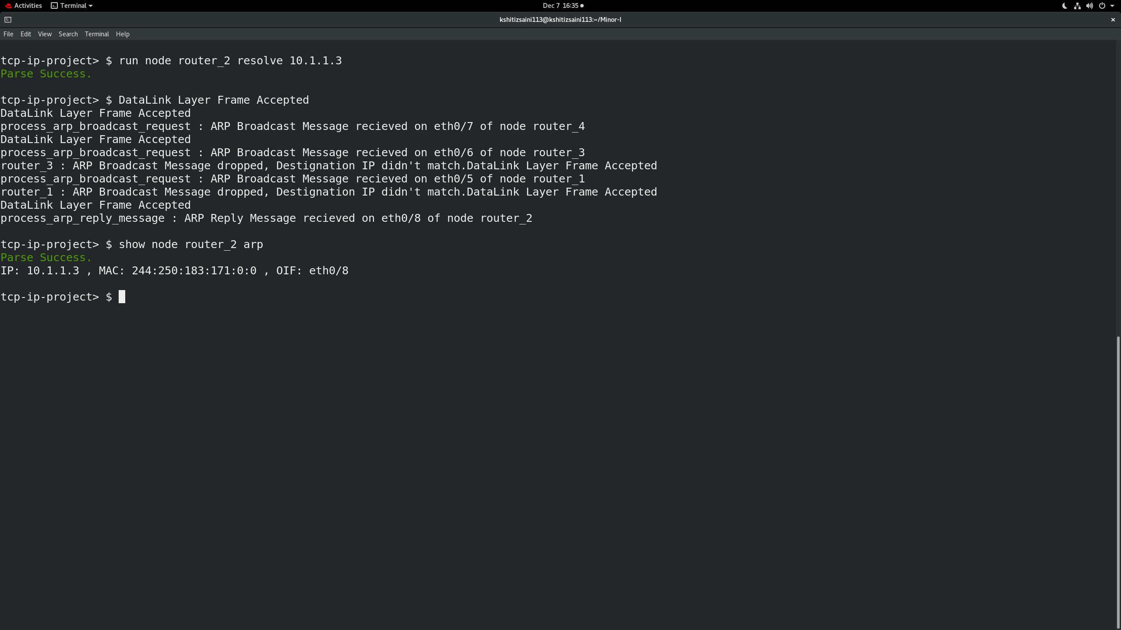
Figure 8 ARP Table Implementation

Slide 25
5.6 Implementing L2-Switching

Slide 26
Layer 2 switching (Data Link layer switching) is the process of using devices' MAC addresses to decide where to forward frames. Switches and bridges are used for Layer 2 switching.
• A device is said to be L3 Router if it’s interfaces are configured with IP-addresses.
• A device is said to be L2 Switch if it’s interfaces are running either in access or trunk mode.
• A device is said to be r-bridges if it acts as both router and switch (Device having dual functionality).
Switch is a layer 2 device which works on the basis of MAC address (physical address) of a device.
It maintains a MAC-table. A switch builds its MAC address table by recording the MAC address of each device connected to each of its ports. The switch uses the information in the MAC address table to send frames destined for a specific device out the port, which has been assigned to that device.

Slide 27
ALGORITHM:
1. Host Machine send the frame along with the Mac Address of the source machine which is received by the L2 interface of the Routing device.
2. The switch learns the MAC address of the device on the switch port on which it receives the frame. It suddenly makes an entry in its Mac table.
3. The switch does 2 types of message forwarding:
• If it has an entry for destination MAC address in its MAC address table , it unicast the frame to the destination.
• If switch has no entry for destination MAC address in its MAC table then the switch simply broadcast the frame through all ports. This is known as flooding.
4. The frame will be forwarded through that switch port only for which the switch has already learned the MAC address in its MAC table.
5. The frames is retarded if the corresponding MAC address is not learnt.

Slide 28
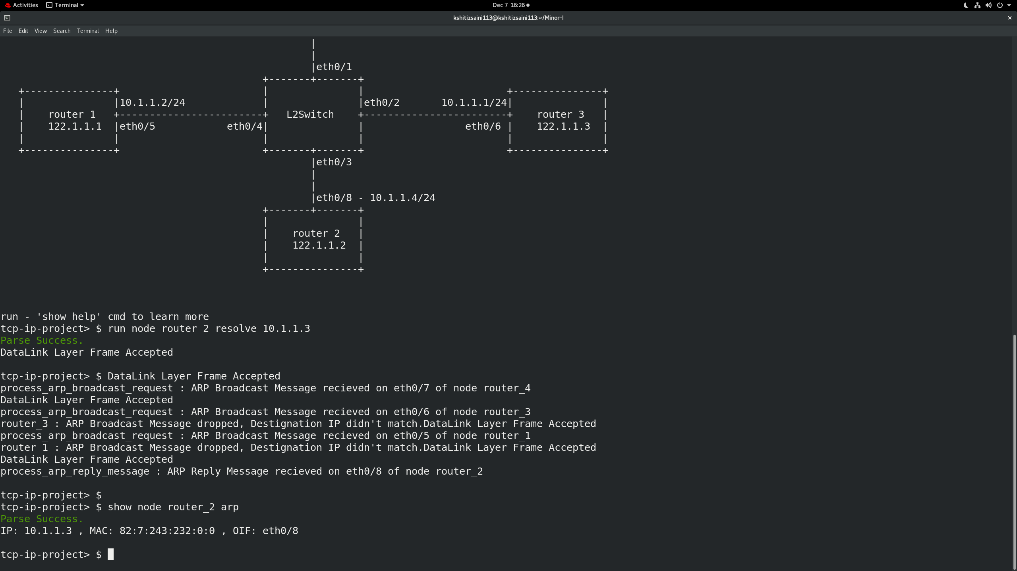
Figure 9 Mac Table Implementation

Slide 29
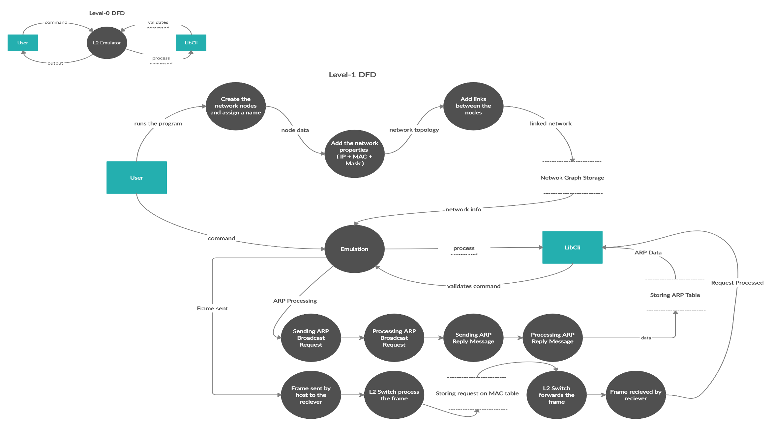
5.7 Data Flow Diagram

Slide 30
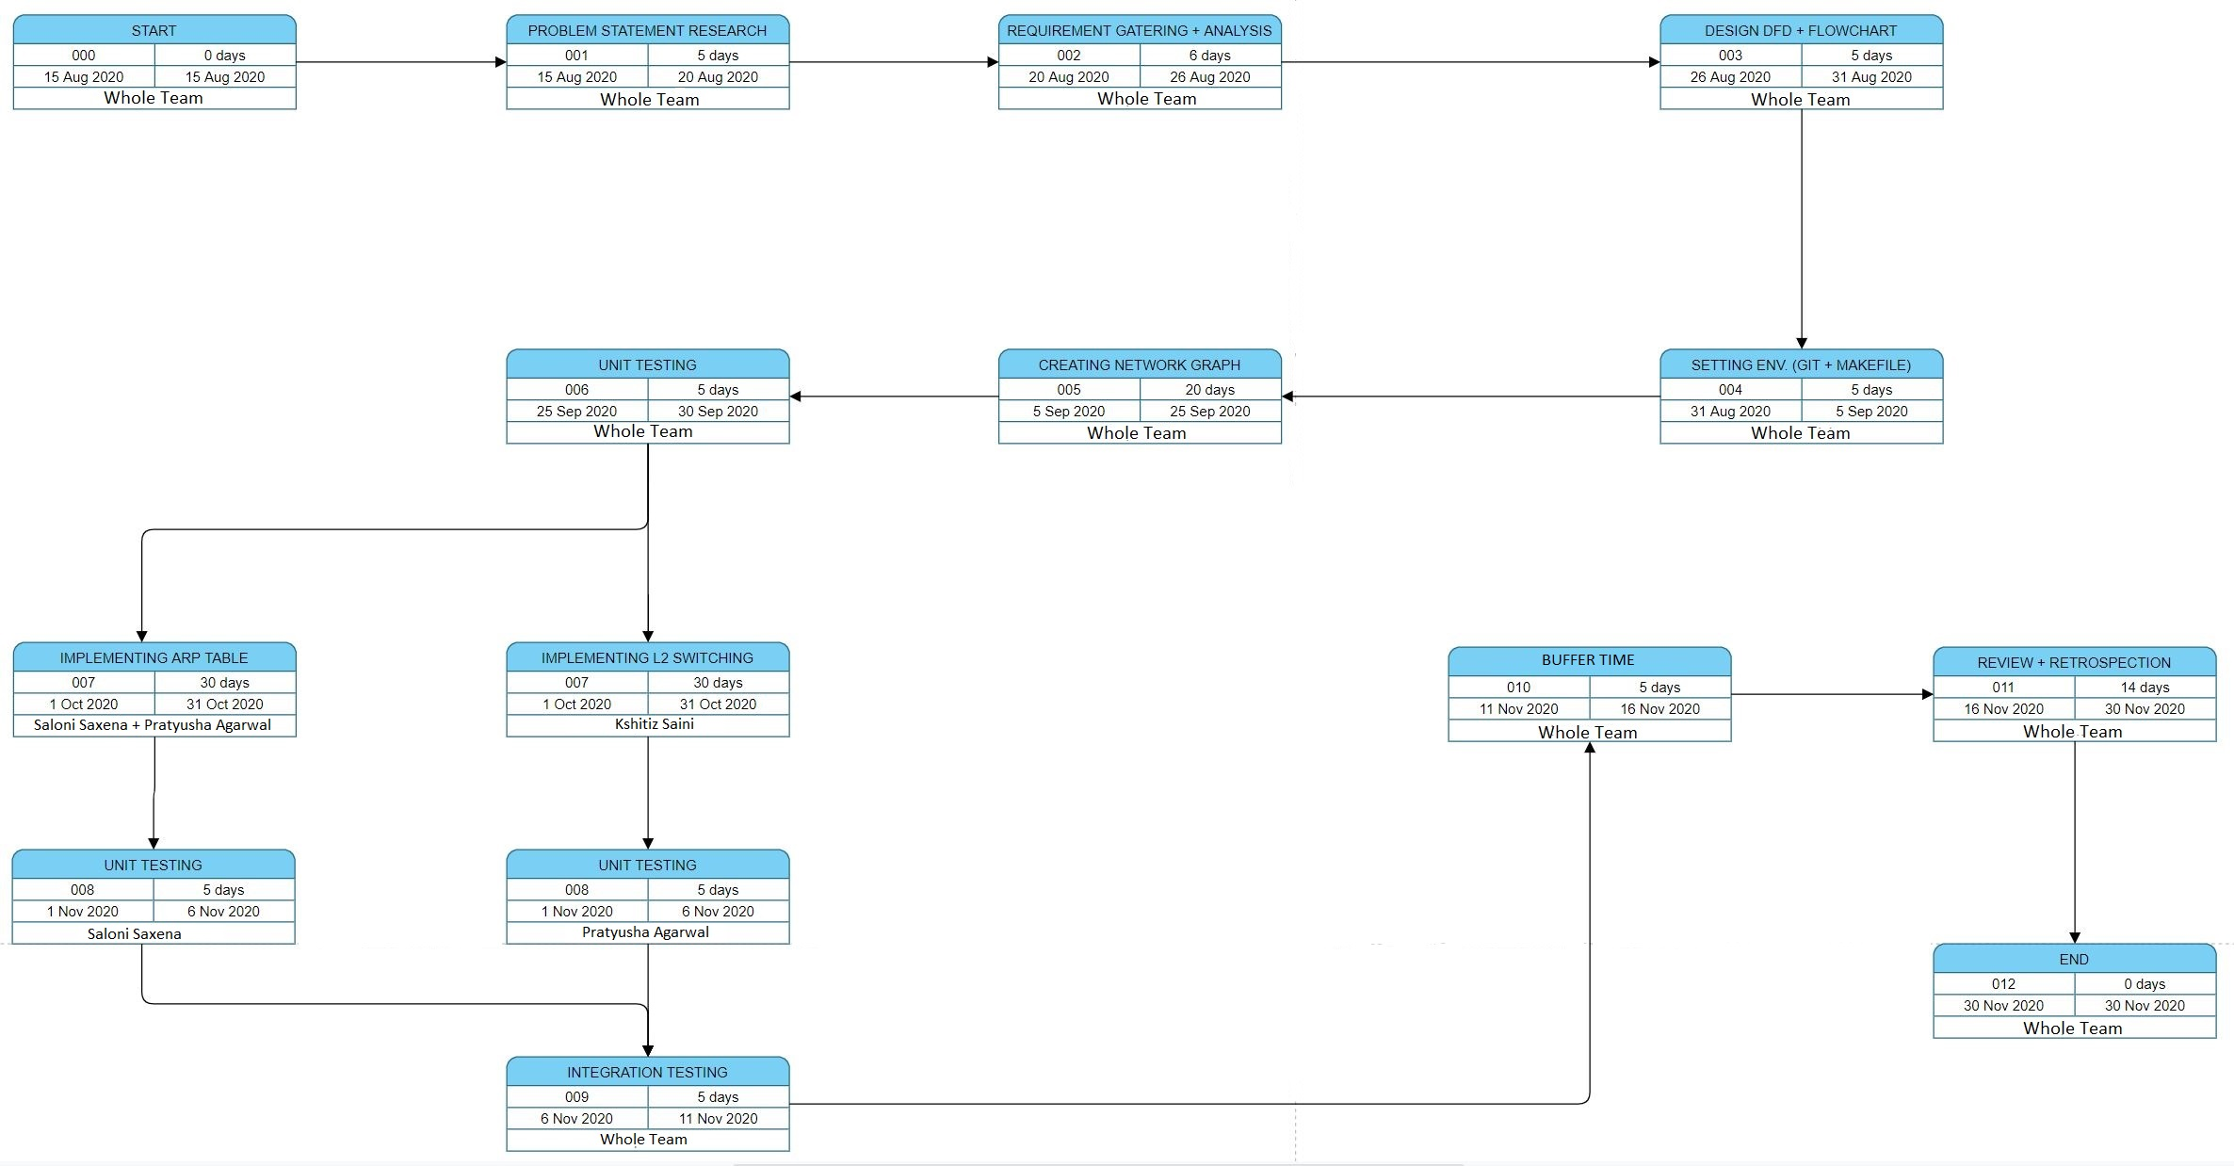

6. Pert Chart

Slide 31
7. References
[1] C Plummer, “An Ethernet Address Resolution Protocol” : Massachusetts Institute of Technology (MIT), Internet Engineering Task Force, 1982
[2] M. Ernesto Gomez-Romero, M. Reyes-Ayala, E. Alejandro, Aandrade-Gonzalez, J. Alfredo and Tirade-Mendez , “Design and Implementation of a VLAN” : Metropolitan Autonomous University, Cinvestav Applied Computer Conference, 2011
[3] F. Balay and MorethanIP , “L2 Switch Implementation with programmable logic devices” : Germany
[4] Socilyzer, “Interpreting Social Network Diagram”: Graph Interpretation, Socilyzer

Slide 32
Thank You

